Slide 1
Making your home a hog heaven!

Slide 2
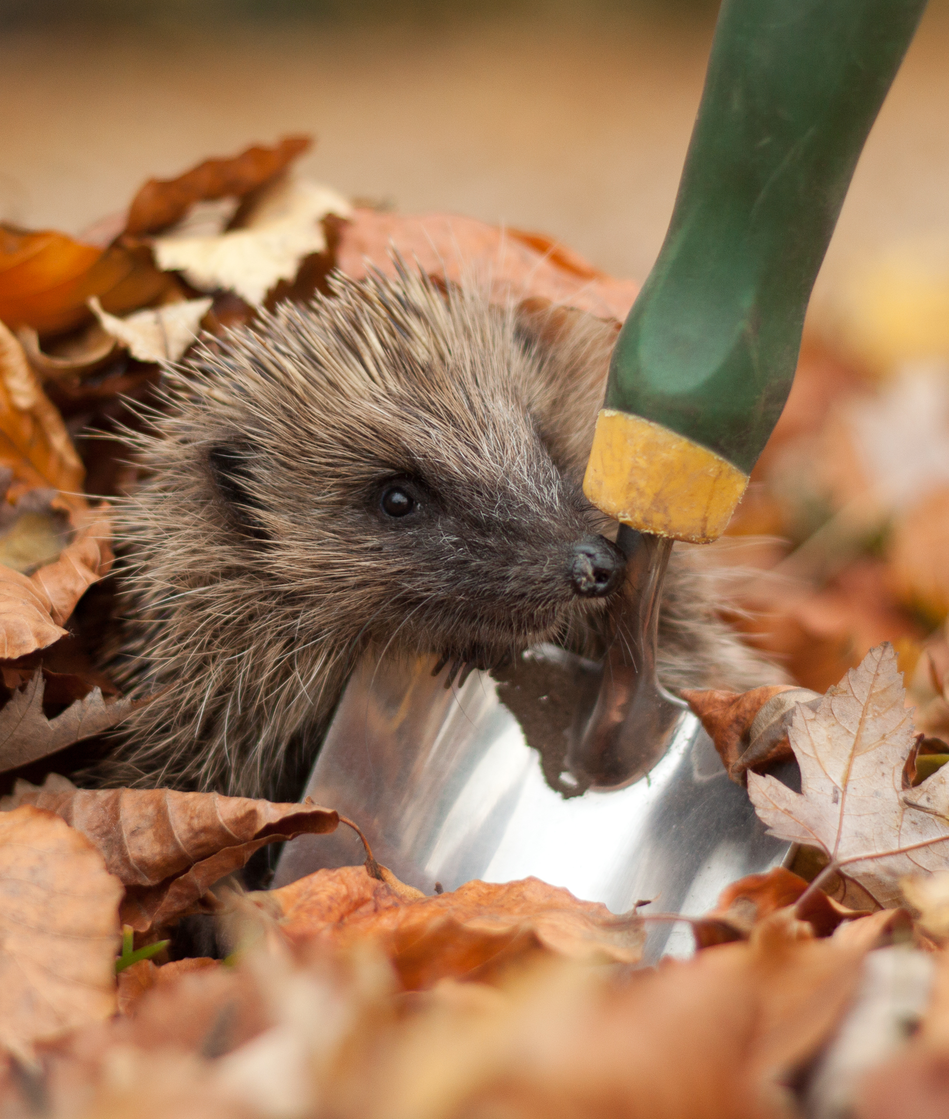
Hedgehog 101
Range: Throughout the UK, moving through hedgerows, gardens parks, woodlands cemeteries and more. Traveling 1-2 km a night within home territories of 10-20 hectares (25-50 football fields).
Age: Live for 2-5 years in the wild (10 in capt.)
Species: 14 different hog species worldwide. We have the honour or housing the European hedgehog. Breeding: Mostly in May and June. Grunting and snorting can be heard during courtship as male hogs circle females trying to persuade her to mate.
Spines: Adults have up to 7,000 spines!
Hibernation: Oct-Apr, must have fed intensively and be in great condition before hibernating to survive the winter.
Population: Hog numbers have fallen by 30% in the last 10 years. Fewer than 1 million thought to be left in the UK. Reducing as fast as tigers worldwide.

Slide 3
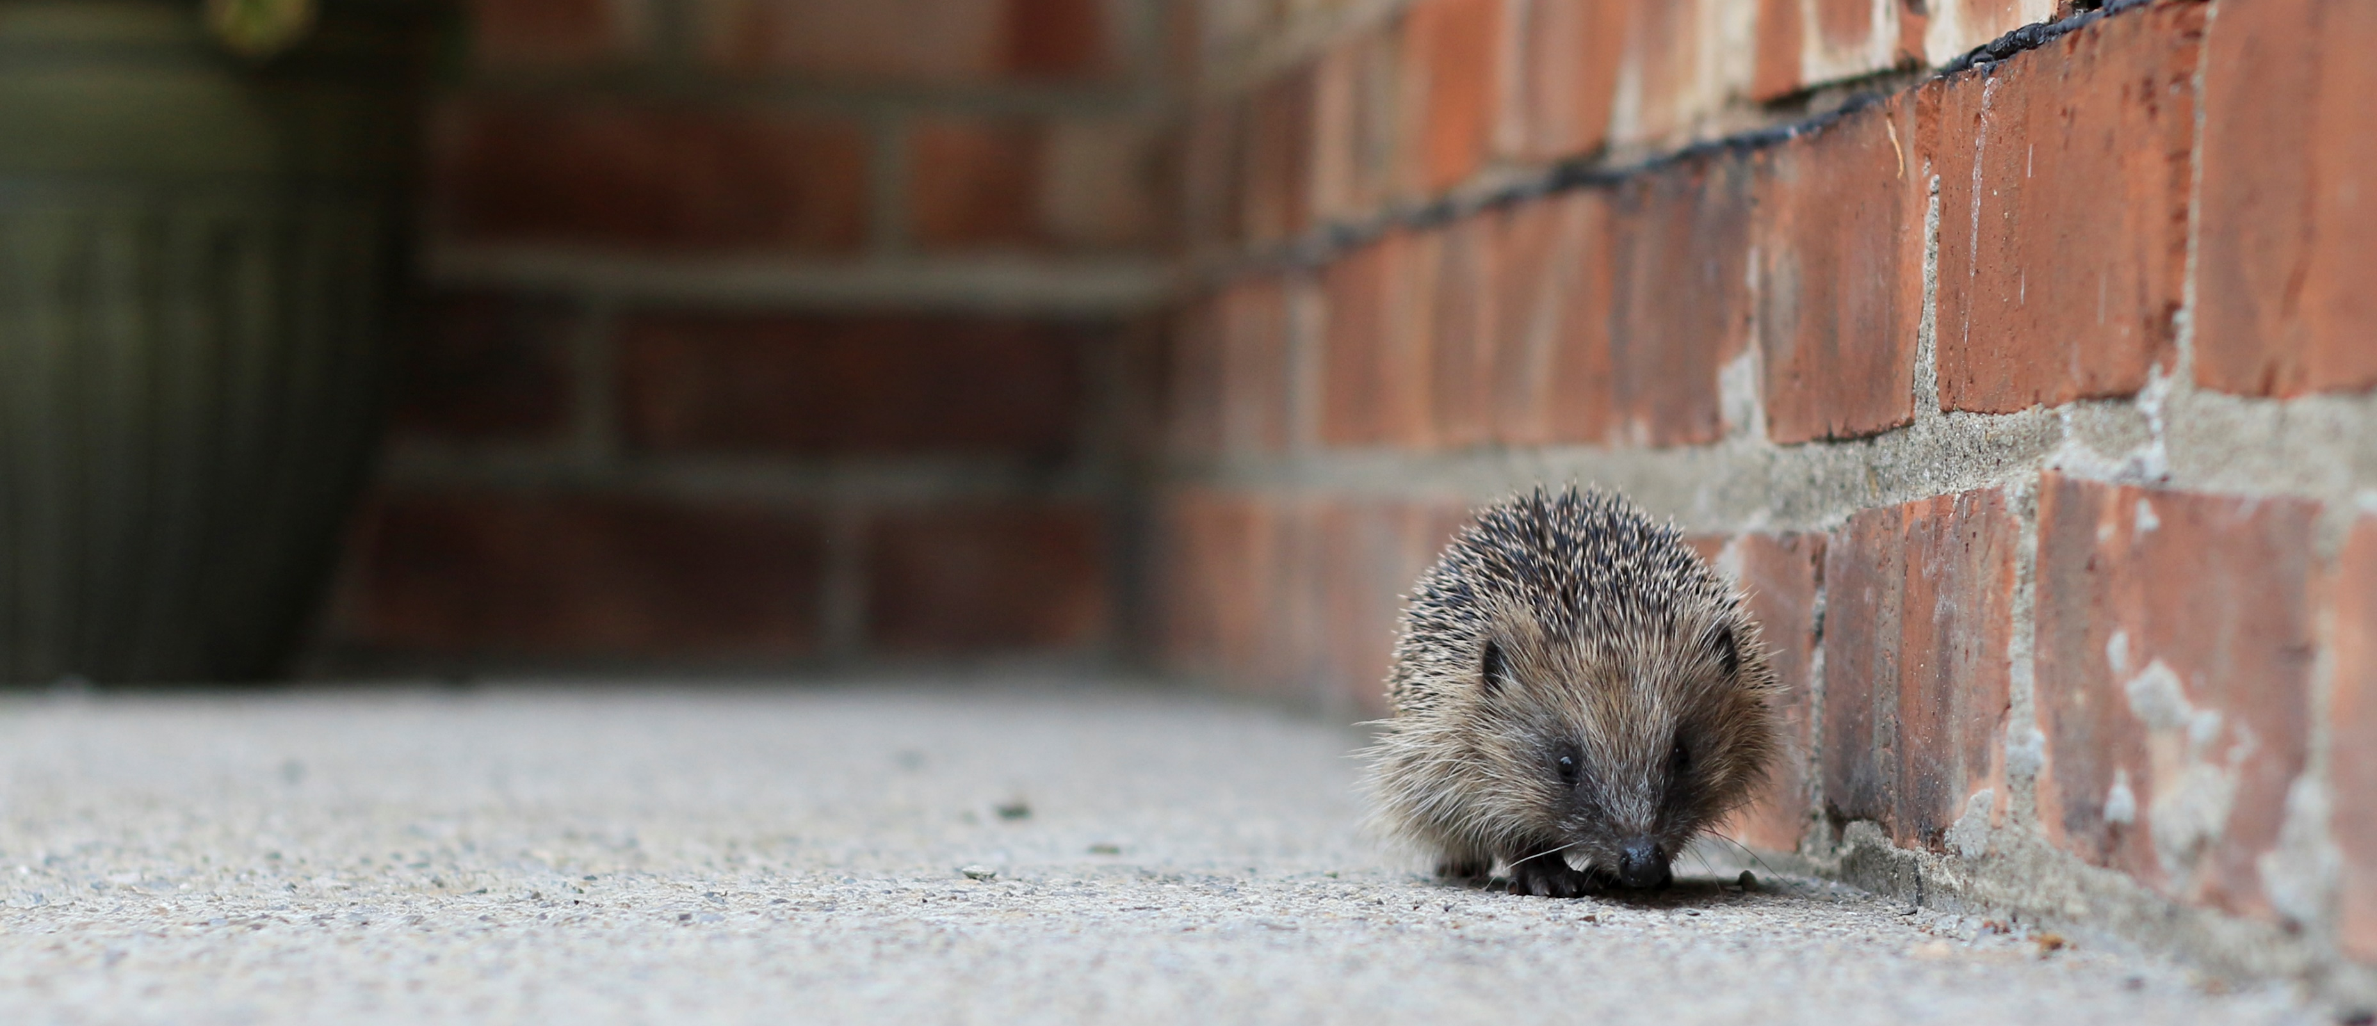
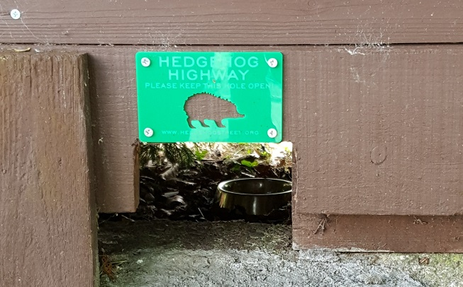
Hedgehog Highway
Hedgehog highway: A neighbourhood project A hole in your fence to help the hogs move is a great start! However, by coming together as a street and creating holes in all fences you provide a wonderful opportunity for hogs to roam freely and increase their chances of finding food and shelter. How to:
13cm by 13cm is sufficient for any hedgehog to pass through but also stop pets escaping. This will be too small for nearly all pets
Ensure holes are at ground level and don’t open out onto busy roads
Best of the best: If you’re feeling ambitious the ideal option would be to change your fence or wall for a native hedgerow, thereby providing food, shelter and a route in and out of your garden.

Slide 4
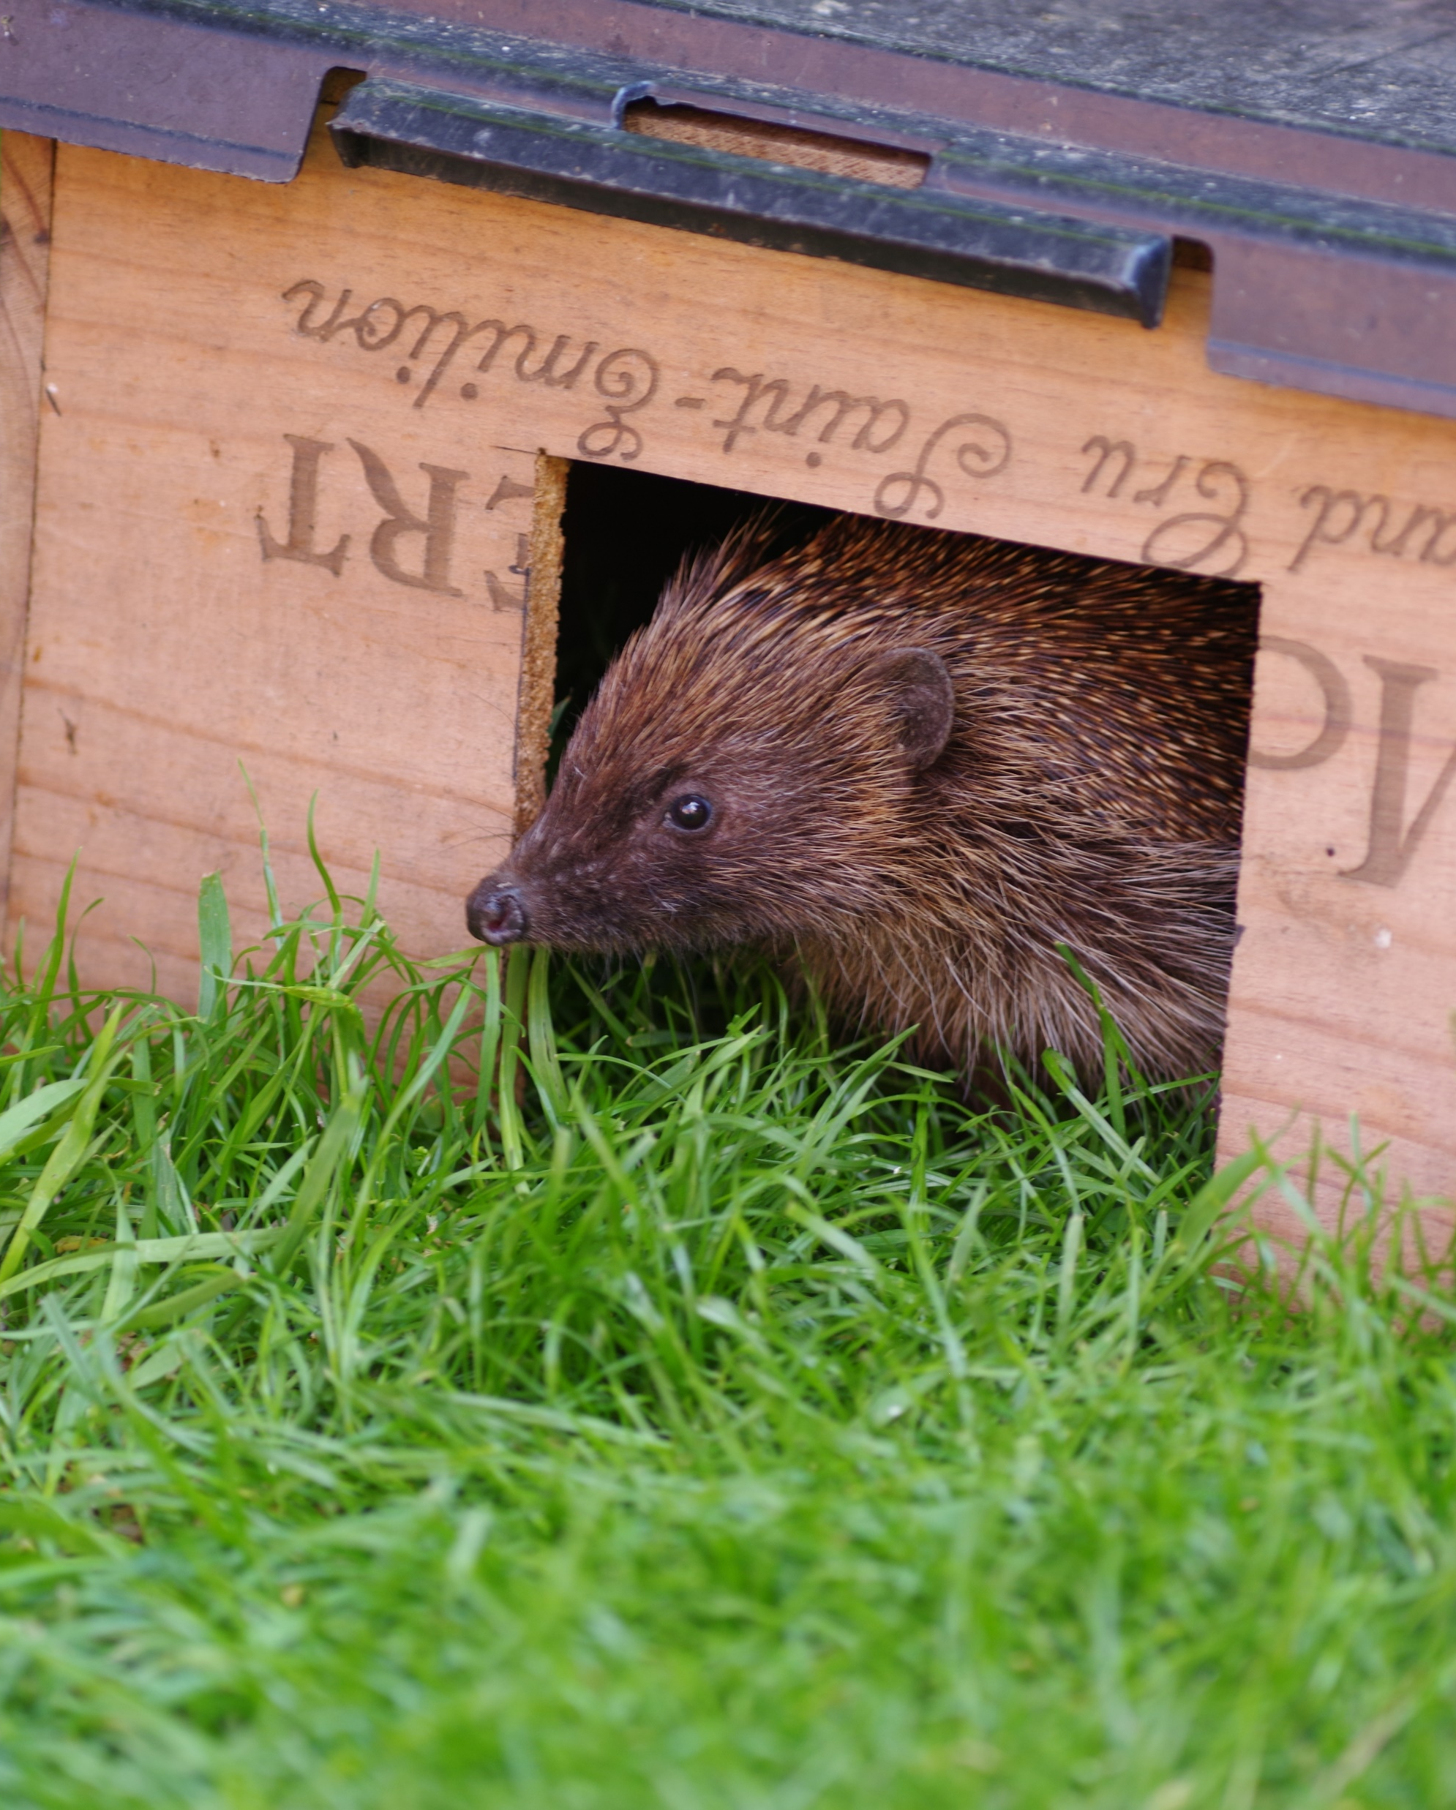
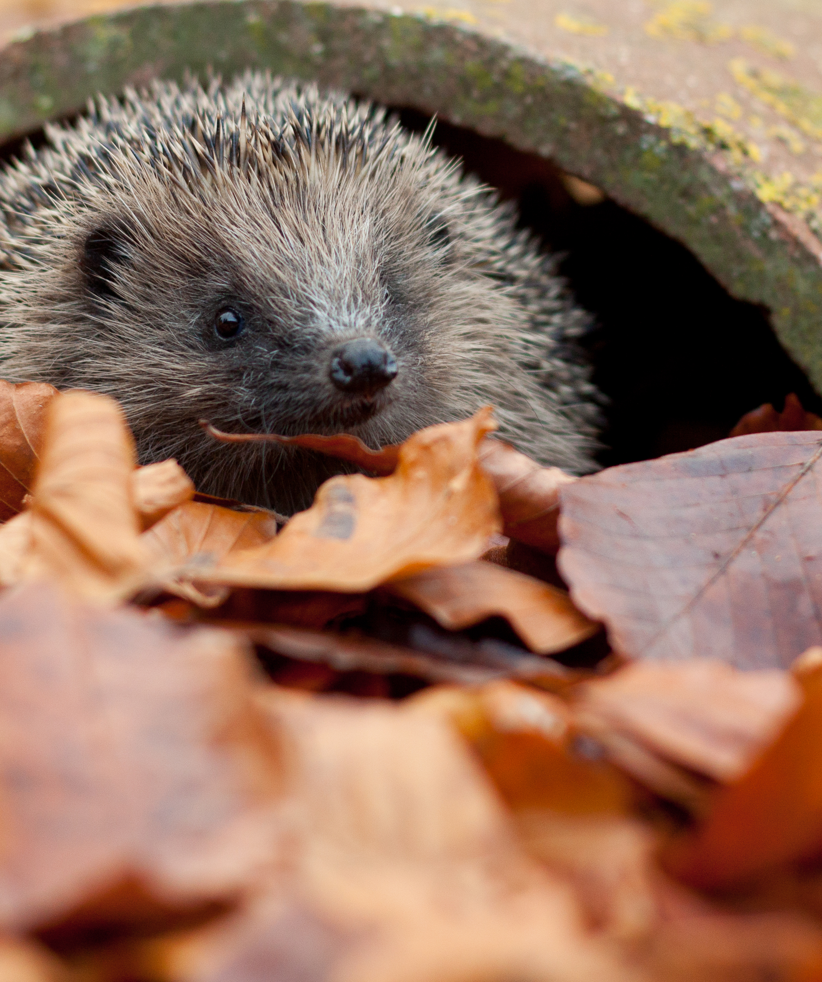
Garden Hog Heaven
Grow a wide variety of plants: The RHS have some incredible lists of plants that help to attract a diverse array of insects which hedgehogs then predate on. Earthworms, caterpillars and beetles are some of their favourites. Alternatively letting your grass grow long also works to attract hog prey.
Ditch the slug pellets and avoid the use of pesticide: Hedgehogs are natural “pest” controllers and need a plentiful and varied supply of invertebrate prey to stay healthy.
Fortify your pond: Hedgehogs are great swimmers but can sometimes struggle to climb out of steep sided ponds and many drown. Provide a ramp from a plank wrapped in chicken wire or create shallow areas at the edge so they can scramble out.

Slide 5
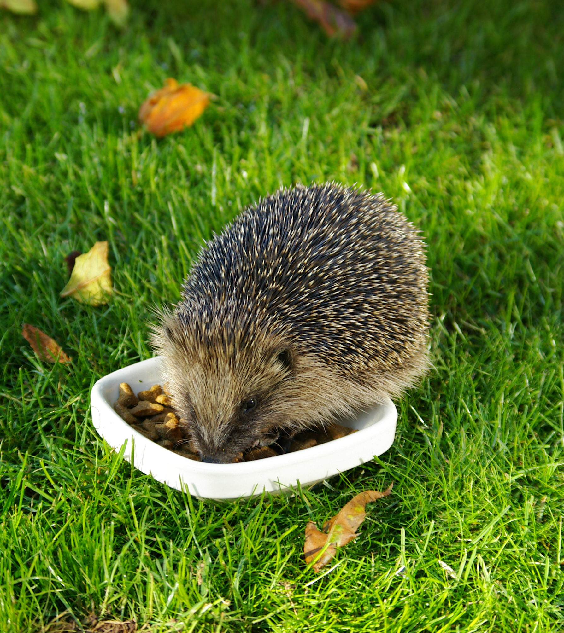
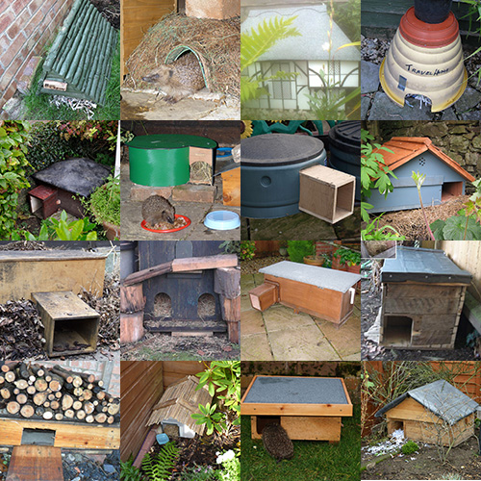
Garden Hog Heaven #2
Nesting sites: Log and leaf piles along with compost heaps can be great nesting sites for those spiny hogs! Check out the GWT site on how to create your own purpose-built hedgehog home!
Be aware of dangers: Check for hidden hedgehogs before lighting bonfires, strimming and mowing the lawn. Keep plant netting, tennis nets and household rubbish above ground level to prevent entanglement.
Provide ample food in other ways: Fallen leaf pile = attracts beetles Mulch beds with garden compost = Encourages plenty of earthworms, woodlice and beetles Wood pile: Creates a feast of earwigs, centipedes and woodlice Build a bug hotel: Stuff it with lots of straw and hollow plant stems and earwigs, centipedes and woodlice will soon make it their home. Provide supplementary meaty foods: wet dog or cat food
Provide supplementary food: Such as wet dog or cat food or dry kitten food (high in protein). Also providing shallow dish of water will help too.
Notes:
https://www.hedgehogstreet.org/help-hedgehogs/feed-hedgehogs/
Constantly putting out food can make wild mammals reliant on unnatural food sources. But putting out a bit of food during winter allows them to top up any low stocks, and gives them a helping hand through the cold and harsh weather.
Put out fresh food at dusk and don't forget a dish of fresh water!
WHAT A WORM WANTS
If you want to encourage or sustain a healthy population of worms there are a few things you can do to improve the conditions for them:
Reduce tilling your soil.
Leave organic matter on the surface.
Add manure and compost.
Ditch the chemicals.
Use an organic mulch to keep soil moist and cool.

Slide 6
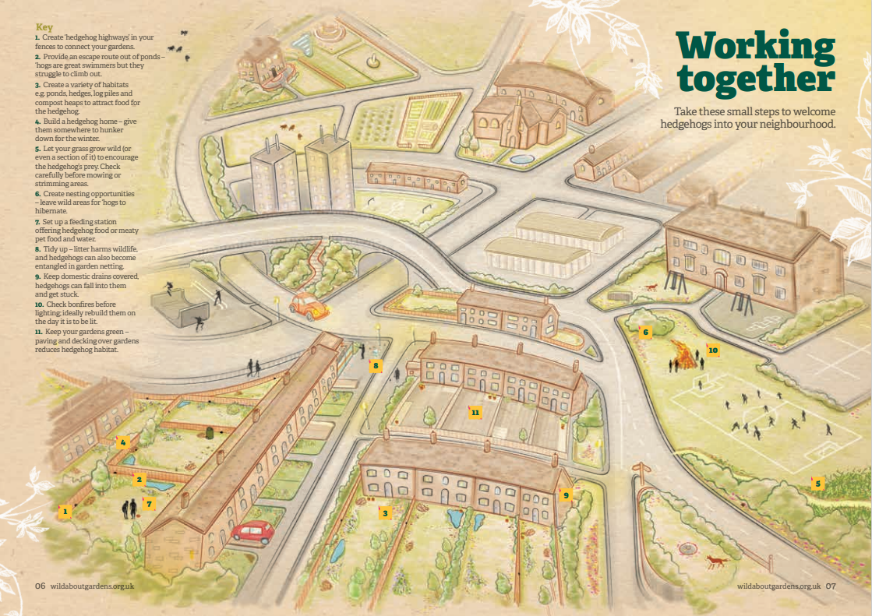
Notes:
Key 1. Create ‘hedgehog highways’ in your fences to connect your gardens. 2. Provide an escape route out of ponds – ‘hogs are great swimmers but they struggle to climb out 3. Create a variety of habitats e.g. ponds, hedges, log piles and compost heaps to attract food for the hedgehog. 4. Build a hedgehog home – give them somewhere to hunker down for the winter. 5. Let your grass grow wild (or even a section of it) to encourage the hedgehog’s prey. Check carefully before mowing or strimming areas. 6. Create nesting opportunities – leave wild areas for ‘hogs to hibernate. 7. Set up a feeding station offering hedgehog food or meaty pet food and water. 8. Tidy up – litter harms wildlife, and hedgehogs can also become entangled in garden netting. 9. Keep domestic drains covered, hedgehogs can fall into them and get stuck. 10. Check bonfires before lighting; ideally rebuild them on the day it is to be lit. 11. Keep your gardens green – paving and decking over gardens reduces hedgehog habitat.

Slide 7
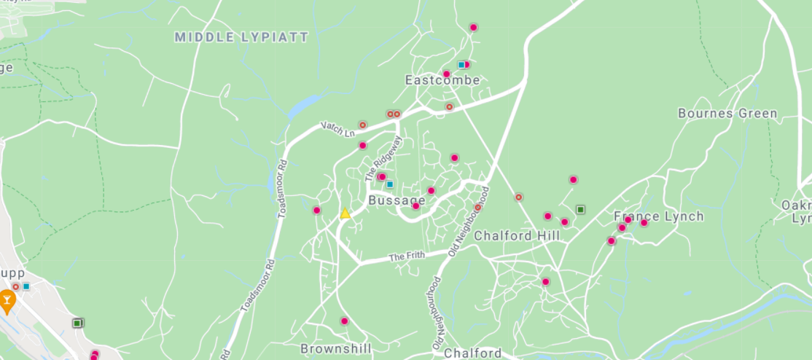
The BIG Hedgehog Map
Notes:
How can I stop cats and foxes eating it all?
Be aware that putting any food out will attract all sorts of wildlife and not just hedgehogs, this includes predators.
To avoid the food you put out being eaten by pets or foxes you could make a feeding station that is difficult for anything larger than a hedgehog to access.
You could use a piece of piping, or build a shelter out of bricks and paving stones or get some inspriation from a nifty solution by Hedgehog Champions below.
Can you feed hedgehogs bread and milk?
Hedgehogs are lactose intolerant so please do not give them milk. Bread is low in energy so fairly worthless to them.
What to do if you find a hedgehog that looks unwell? If you spot a hedgehog at night and it looks healthy then the best thing you can do is leave it alone. Hedgehogs are wild animals and so can get very easily stressed by human contact. If the sighting is during the day – it could be a warning sign that all is not well. However, there are some exceptions, nest disturbance, females nest building in preparation for young to be born or feeding while young are asleep being some. Those hedgehogs will generally be moving quickly, appear well and only out for short periods of time. Monitor from a distance to ensure no problems develop and if in doubt call the British Hedgehog Preservation Society on 01584 890 801. However if you find a hedgehog staggering around, lying still (not in a nest), with flies around it or obviously sick or injured be it day or night, it needs urgent help.
How do I know if I have hedgehogs? Hedgehog poop is quite recognisable; keep an eye out for dark pellets the size of your little finger containing shiny insect remnants.
Hedgehog footprints are unique so if you have any wet earth, sand or want to use a proper mammal surveying tunnel you can see if hogs are using your garden.
If you have a hedgehog house, place some leaves/bedding near the house entrance – a hedgehog will likely drag this into the house for nesting, so look out for bedding that has been moved.
When making your hedgehog home: Some things to bear in mind are:
When siting the box choose a shady, quiet area of your garden.
If the box lacks a tunnel entrance, try to include an interior tunnel or dividing wall to prevent predators such as badgers or foxes from getting to the hedgehog with their paws.
We recommend using untreated wood for hedgehog homes. Wood from certain softwood tree species grown in the UK, such as larch, Douglas-fir and red cedar have excellent durability as exterior timbers. Pre-treated wood can contain chromated copper arsenate (CCA) compounds that are hazardous to many species. PTES promote the use of locally grown timber which encourages good woodland management practices.
Consider rigging up a trail camera to keep an eye on who’s about.

